Slide 1

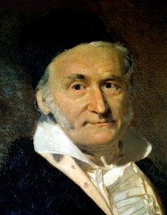
Gauss
Prince of Mathematicians
Done by:
Reem Isa (20110429)
Dalal Mohammed (20111454)
Dalal khalid Ali (20123336)
Fatima Mubarak (20123106)
Aisha saleh (20123627)

Slide 2
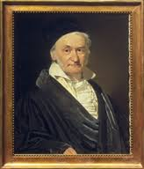
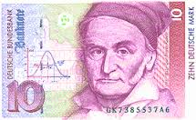
General information
Name: Johann Carl Friedrich Gauss
Born: April 30- 1777 Brunswick, Germany
Early life: Born to a very poor family, his father was gardener and brick layer, Gauss was a child prodigy,
3 years old he corrected an error in his father payroll calculations
5 years old: he was looking after his father’s accounts on a regular basis
7 years old: he summing the integers from 1 to 100 almost instantly
12 years old : he was already attending gymnasium and criticizing Euclid’s geometry.
15 years old: Duke of Brunswick sent him to the Collegium Carolinum and then to the prestigious University of Gottingen.
Later life: he was appointed a Geheimrat; a privy councilor عضو مجلس خاص
featured on the 10 Deutsche Mark note
Died: February 23 1855 Göttingen, Germany.

Slide 3
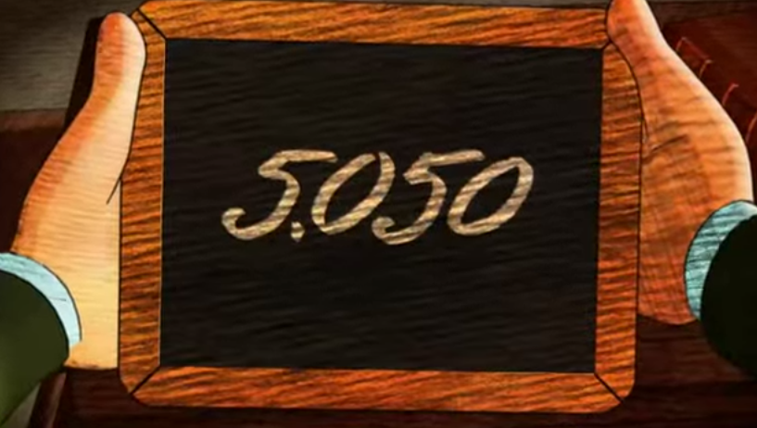
Genius Gauss
when he was nine. At the beginning of the year, to keep his 100 pupils occupied, the teacher,
J. G.Buttner, assigned them the task of summing the first 100 integers.
He had barely finished explaining the assignment Gauss wrote the single number 5050 on his slate and deposited it on the teacher’s desk.
How ?

Slide 4
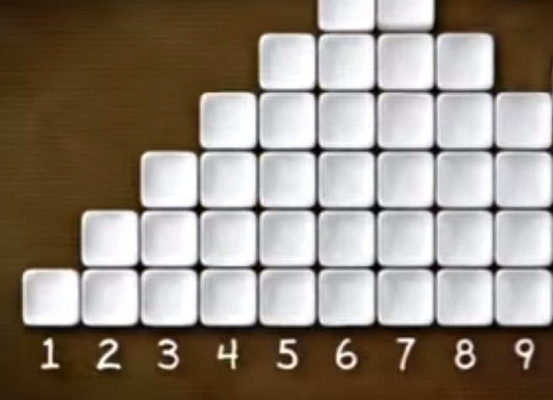
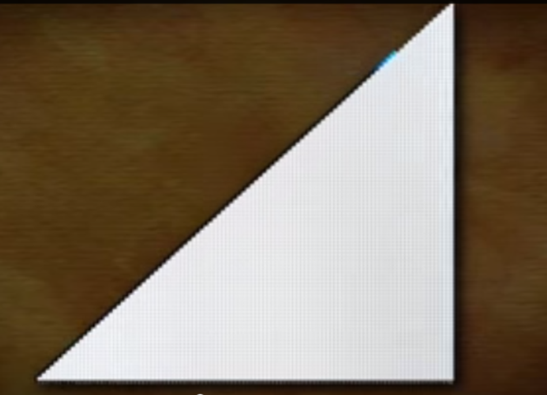
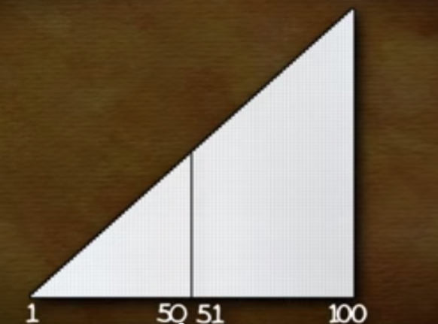
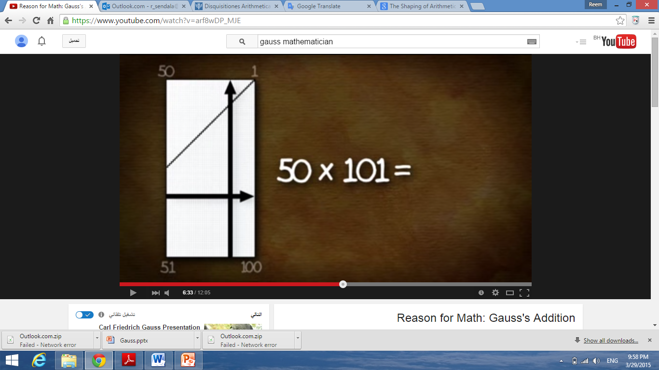
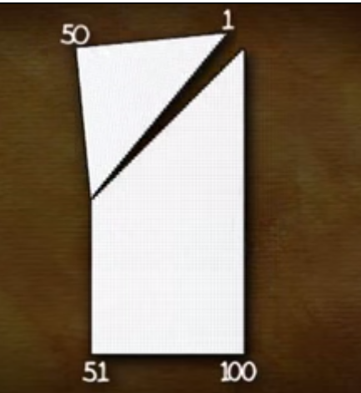
To find the area = L.W
(First number + last number )
X
(Half of total digits being added )
=
(1+100) x (50) = 5050
First number + last number
Half of total digits being added

Slide 5
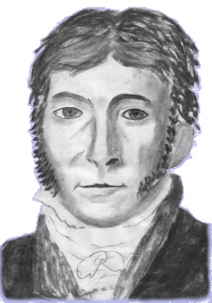
Carl Friedrich Gauss
He was one of the most intelligent and productive mathematicians ever and made contributions in every mathematical field

Slide 6
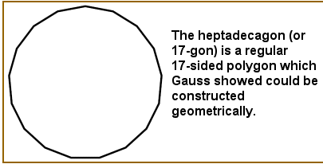
submitted the first rigorous proof of the fundamental theorem of algebra
contribution to number theory
discover polygon with 17 sides could be drawn with only a strait edge and compass
calculate the paths of planets with a minimum of known data
invent the telegraph

Slide 7
Gauss elimination
We have three equations:
X +3y+ Z = 10
X - 2y- Z = -6
2 X +y+ 2 Z = 10
What we will do to find the value of X, Y, Z ?
1 3 1 10
1 -2 -1 -6
2 1 2 10
1 n n n
0 1 n n
0 0 1 n

Slide 8
-1. R1 + R2 R2
-2. R1 + R3 R3
1 3 1 10
0 -5 -2 -16
2 1 2 10
1 3 1 10
0 -5 -2 -16
0 -5 0 -10
=

Slide 9


R2 R3
- R2+ R3 R3
1 3 1 10
0 -5 0 -10
0 -5 -2 -16
1 3 1 10
0 -5 0 -10
0 0 -2 -6
$\frac{−1}{5}$ R2 R2
$\frac{−1}{2}$ R3 R3
1 3 1 10
0 1 0 -2
0 0 -2 -6
1 3 1 10
0 1 0 2
0 0 1 3

Slide 10
X + 3Y + Z = 10
Y = 2
Z= 3
X + 3(2) + 3 = 10
X + 6 + 3 = 10
X + 9 = 10
( 1, 2, 3 )
(x, y , z )

Slide 11
Resources:
Mastin L (2010) 19TH CENTURY MATHEMATICS – GAUSS , the story of mathematics from: http://www.storyofmathematics.com/19th_gauss.html
Famouse scientist team (2015) , Carl Friedrich Gauss , from http://www.famousscientists.org/carl-friedrich-gauss/
Katz, V. (2009). The Beginnings of Mathematics in Greece. In A history of mathematics (3rd ed., pp. 39-41). Columbia: Pearson Education.
http://www.storyofmathematics.com/19th_gauss.html
http://mathematica.ludibunda.ch/mathematicians4.html
http://www.keplersdiscovery.com/Gauss.html
http://www.powershow.com/view/1202c0-MTRmN/Carl_Friedrich_Gauss_powerpoint_ppt_presentation
https://www.youtube.com/watch?v=16xZHmUj7Sc
Photo’s from google images

