Slide 1


University of Bahrain
Bahrain Teachers College
Bernhard Riemann
Done By | ST.ID
- Hawra Jameel Jassim | 20121528
- Kawther Sayed Ahmad | 20113367
-Maria Mohammed | 20120982
- Masooma Aamer | 20122659
Instructor: Dr. Abdullah Eid

Slide 2
Who is Bernhard Riemann?
Name: Georg Friedrich Bernhard Riemann.
Nationality : Germany.
Born on: September 17, 1826 AD , Breselenz.
Died: July 20 ,1866 AD in Italy
Famous as : Mathematician
fields in : mathematics and physics

Slide 3
Contribution and Achievement
He made important contributions to the theory of functions, complex analysis , and numbers theory.
- He introduced a way of generalizing the study of polynomial equations in two real variables to the case of two complex variables. x + iy(where i = √(−1))
- He made the first significant uses of Topology in mathematics.

Slide 4
Contribution and Achievement
Topology of surface
Topology: The study of those properties of geometric forms that remain
Invariant under certain transformations, as bending or stretching.
Riemann showed how such surfaces
can be classified by a number (genus).

Slide 5
Contribution and Achievement
Topology of surface
Genus: The maximal number of closed curves that can be drawn on the surface without splitting it into separate pieces.
* Genus: ( The number of holes )
Genus used in:
Number theory -Areas
- Topology -Complex analysis

Slide 6



Contribution and Achievement
Topology of surface
Examples:
Genus = 0
Genus = 2
Genus = 1

Slide 7
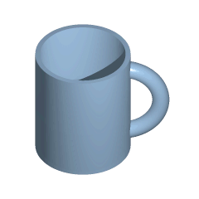
Contribution and Achievement
Topology of surface
What about the genus of cup ?
How that match with Universality properties ?

Slide 8
One of his important Achievement
Approximation of area upper and lower Riemann Sum

Slide 9
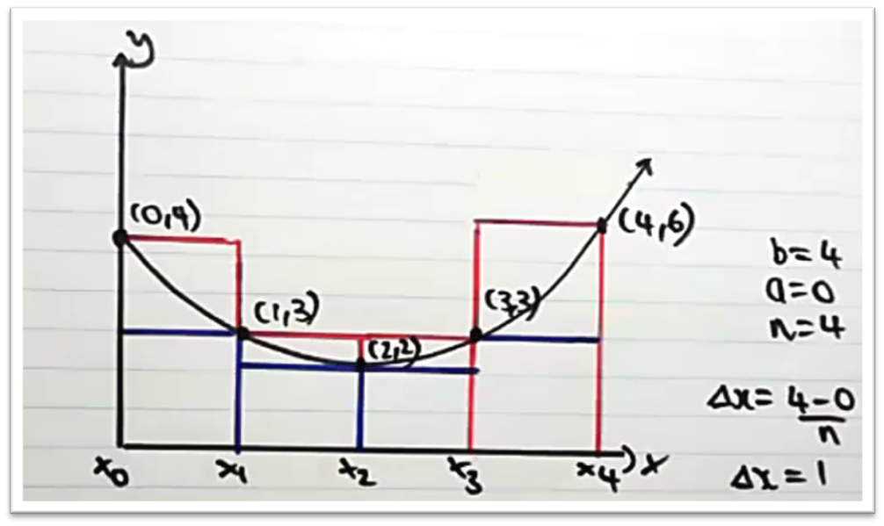
Approximate the area under the curve using “lower and upper Riemann sum” .

Slide 10
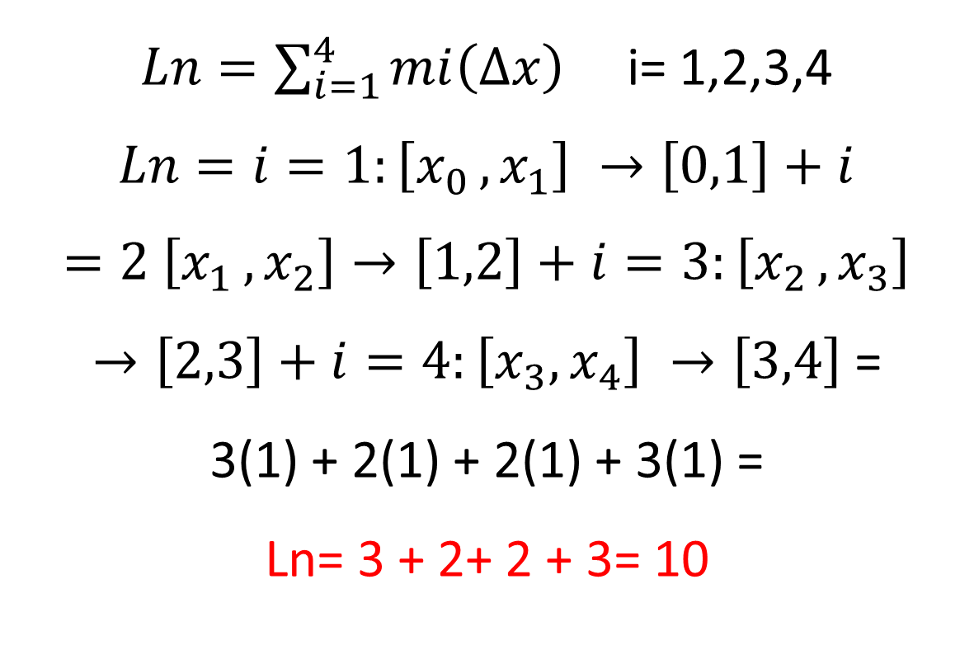
$Ln=\sum_{i=1}^{4}{mi\left(∆x\right)}$ i= 1,2,3,4
$Ln=i=1:\left[x_{0 }, x_{1}\right] →\left[0,1\right]+i=2 \left[x_{1 }, x_{2}\right]→\left[1,2\right]+i=3:\left[x_{2 }, x_{3}\right]→\left[2,3\right]+i=4:\left[x_{3}, x_{4}\right] →\left[3,4\right]$ =
3(1) + 2(1) + 2(1) + 3(1) =
Ln= 3 + 2+ 2 + 3= 10

Slide 11
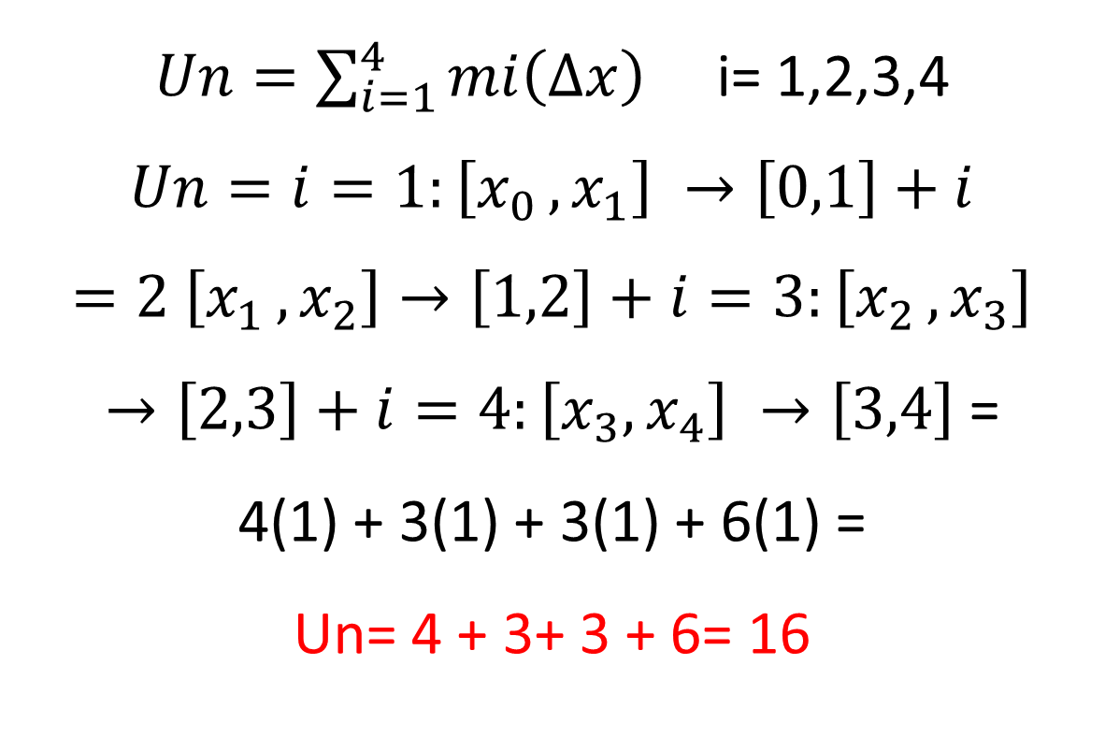
$Un=\sum_{i=1}^{4}{mi\left(∆x\right)}$ i= 1,2,3,4
$Un=i=1:\left[x_{0 }, x_{1}\right] →\left[0,1\right]+i=2 \left[x_{1 }, x_{2}\right]→\left[1,2\right]+i=3:\left[x_{2 }, x_{3}\right]→\left[2,3\right]+i=4:\left[x_{3}, x_{4}\right] →\left[3,4\right]$ =
4(1) + 3(1) + 3(1) + 6(1) =
Un= 4 + 3+ 3 + 6= 16

Slide 12
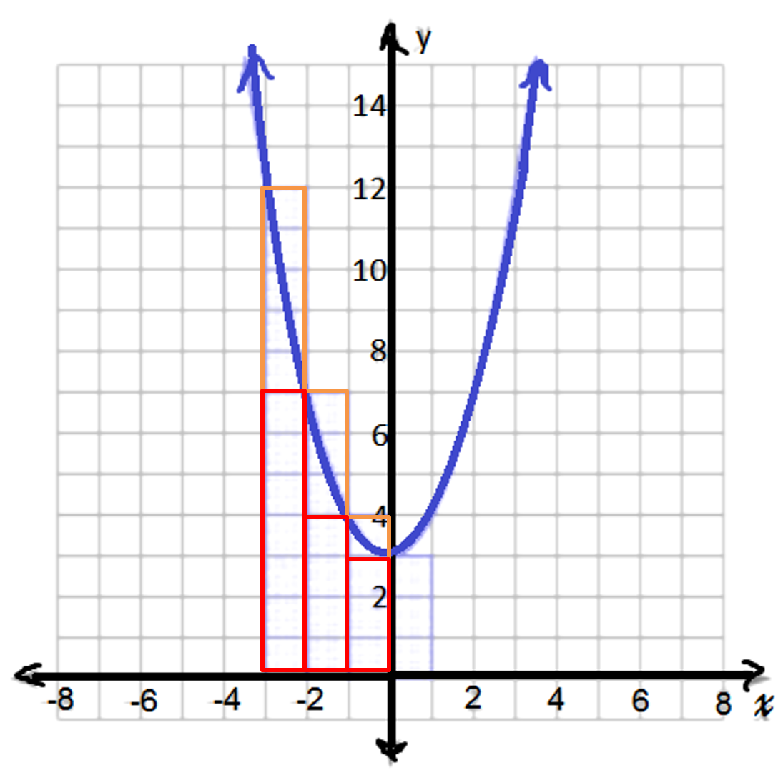
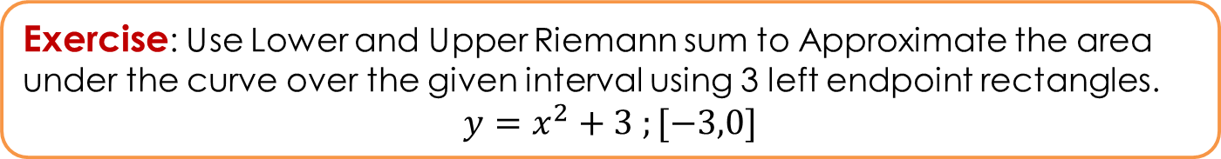
Exercise: Use Lower and Upper Riemann sum to Approximate the area under the curve over the given interval using 3 left endpoint rectangles.
$$y=x^{2}+3 ;[−3,0]$$
Notes:
http://cdn.kutasoftware.com/Worksheets/Calc/06%20-%20Approximating%20Area%20Under%20Curve.pdf

Slide 13
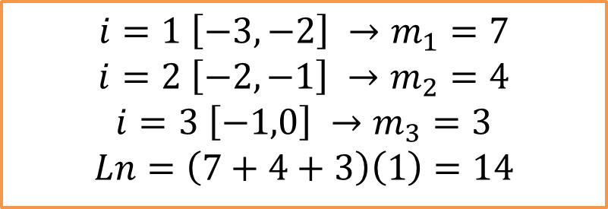
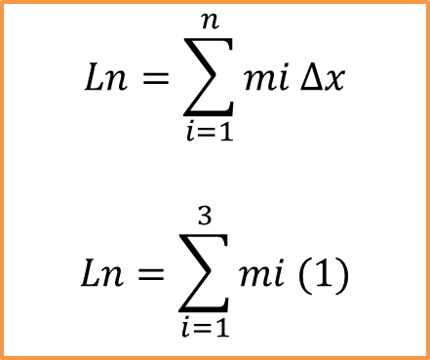
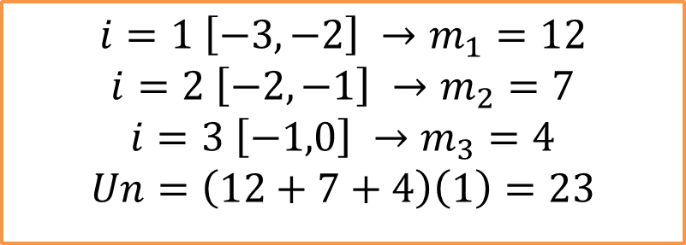
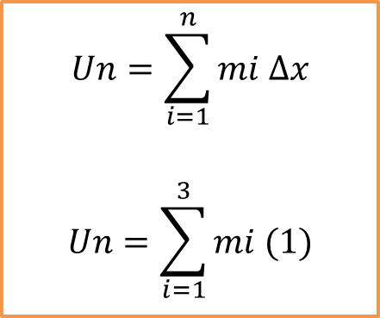
Solution
$$Ln=\sum_{i=1}^{n}{mi ∆x}$$
$$Ln=\sum_{i=1}^{3}{mi (1)}$$
$$i=1 \left[−3,−2\right] →m_{1}=7$$
$$i=2 \left[−2,−1\right] →m_{2}=4$$
$$i=3 \left[−1,0\right] →m_{3}=3$$
$$Ln=\left(7+4+3\right)\left(1\right)=14$$
$$Un=\sum_{i=1}^{n}{mi ∆x}$$
$$Un=\sum_{i=1}^{3}{mi (1)}$$
$$i=1 \left[−3,−2\right] →m_{1}=12$$
$$i=2 \left[−2,−1\right] →m_{2}=7$$
$$i=3 \left[−1,0\right] →m_{3}=4$$
$$Un=\left(12+7+4\right)\left(1\right)=23$$

Slide 14
Do you have any questions?

Slide 15
Thank you for listening

Slide 16
References
https://www.youtube.com/watch?v=zLW96keCzW0
Riemann Center for Geometry and Physics (2013) Retrieved from http://riemanncenter.de/riemann.html
NNDB(2014) Retrieved from: http://www.nndb.com/people/359/000087098/
Jeremy John Gray. 2014. Encyclopedia Britannica . [ONLINE] Available at:http://www.britannica.com/EBchecked/topic/503201/Bernhard-Riemann. [Accessed 28 March 15].
(2006). Retrieved from kuta software: http://cdn.kutasoftware.com/Worksheets/Calc/06%20-%20Approximating%20Area%20Under%20Curve.pdf
Online Dictionary
http://dictionary.reference.com/browse/topology
Pictures from http://en.wikipedia.org/wiki/Genus_(mathematics)
Friedrich E. P. Hirzebruch and Matthias Kreck. 2009. On the Concept of Genus in Topology and Complex Analysis. [ONLINE] Available at: http://www.ams.org/notices/200906/rtx090600713p.pdf. [Accessed 04 April 15].

